Slide 1
CSM 491 - Graph Theory and Its Application
Lectures 8
by
Dr. Oliver Kornyo
Dept. of Computer Science

Slide 2
DIRECTED GRAPHS
Lecture Outline
What is a Directed Graph?
Isolated Vertex
Diagraphs
Isomorphic Diagraphs
Reflexive Relation
Symmetric Relation
Equivalence Relation

Slide 3
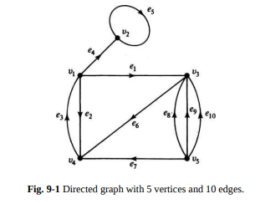
WHAT IS A DIRECTED GRAPH?
A directed graph (or a digraph for short) G consists of a set of vertices V = {v1 , v2 , . . .}, a set of edges E = {e1 , e2 , . . .}, and a mapping Ψ that maps every edge onto some ordered pair of vertices (vi , vj ).
As in the case of undirected graphs, a vertex is represented by a point and an edge by a line segment between vi and vj with an arrow directed from vi to vj . For example, Fig. 9-1 shows a digraph with five vertices and ten edges

Slide 4
In a digraph an edge is not only incident on a vertex, but is also incident out of a vertex and incident into a vertex. The vertex vi , which edge ek is incident out of, is called the initial vertex of ek . The vertex vj , which ek is incident into, is called the terminal vertex of ek.
In Fig. 9-1, v5 is the initial vertex and v4 is the terminal vertex of edge e7 . An edge for which the initial and terminal vertices are the same forms a self-loop, such as e5 .
The number of edges incident out of a vertex vi is called the out-degree of vi and is written d + (vi ).

Slide 5
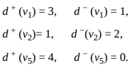
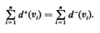
The number of edges incident into vi is called the in-degree of v1 and is written as d − (vi ). In Fig. 9-1, for example
It is not difficult to prove that in any digraph G the sum of all in-degrees is equal to the sum of all out-degrees, each sum being equal to the number of edges in G; that is

Slide 6
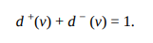
Isolated Vertex
An isolated vertex is a vertex in which the in-degree and the out-degree are both equal to zero. A vertex v in a digraph is called pendant if it is of degree one, that is, if
Two directed edges are said to be parallel if they are mapped onto the same ordered pair of vertices. That is, in addition to being parallel in the sense of undirected edges, parallel directed edges must also agree in the direction of their arrows. In Fig. 9-1, edges e8 , e9 , and e10 are parallel, whereas edges e2 and e3 are not.

Slide 7
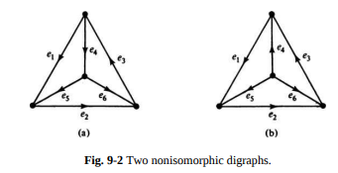
Isomorphic Diagraphs
Isomorphic graphs were defined such that they have identical behavior in terms of graph properties. In other words, if their labels are removed, two isomorphic graphs are indistinguishable.
For two digraphs to be isomorphic not only must their corresponding undirected graphs be isomorphic, but the directions of the corresponding edges must also agree. For example, Fig. 9-2 shows two digraphs that are not isomorphic, although they are orientations of the same undirected graph.

Slide 8
SOME TYPES OF DIGRAPHS
Simple Digraphs: A digraph that has no self-loop or parallel edges is called a simple digraph (Figs. 9-2 and 9-3, for example).
Asymmetric Digraphs: Digraphs that have at most one directed edge between a pair of vertices, but are allowed to have self-loops, are called asymmetric or antisymmetric.
Symmetric Digraphs: Digraphs in which for every edge (a, b) (i.e., from vertex a to b) there is also an edge (b, a).
A digraph that is both simple and symmetric is called a simple symmetric digraph.

Slide 9
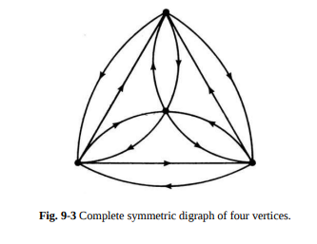
Complete Diagraphs
A complete undirected graph was defined as a simple graph in which every vertex is joined to every other vertex exactly by one edge. For digraphs we have two types of complete graphs.
A complete symmetric digraph is a simple digraph in which there is exactly one edge directed from every vertex to every other vertex (Fig. 9-3), and a complete asymmetric digraph is an asymmetric digraph in which there is exactly one edge between every pair of vertices (Fig. 9-2).

Slide 10
DIGRAPHS AND BINARY RELATIONS
In a set of objects, X, where
a binary relation R between pairs (xi , xj ) may exist. In which case, we write
and say that xi has relation R to xj .

Slide 11
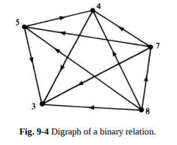
A digraph is the most natural way of representing a binary relation on a set X. Each xi ∈ X is represented by a vertex xi If xi has the specified relation R to xj , a directed edge is drawn from vertex xi to xj , for every pair (xi xj ).
For example, the digraph in Fig. 9-4 represents the relation “is greater than” on a set consisting of five numbers (3, 4, 7, 5, 8}.

Slide 12
Reflexive Relation
For some relation R it may happen that every element is in relation R to itself. For example, a number is always equal to itself, or a line is always parallel to itself. Such a relation R on set X that satisfies
for every xi ∈ X is called a reflexive relation. The digraph of a reflexive relation will have a self-loop at every vertex. Such a digraph representing a reflexive binary relation on its vertex set may be called a reflexive digraph. A digraph in which no vertex has a self-ioop is called an irreflexive digraph.

Slide 13
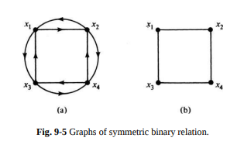
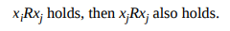
Symmetric Relation
For some relation R it may happen that for all xi and xi if xiRxj holds, then xjRxj also holds.
Such a relation is called a symmetric relation. “Is spouse of” is a symmetric but irreflexive relation. “Is equal to” is both symmetric and reflexive.
The digraph of a symmetric relation is a symmetric digraph because for every directed edge from vertex xi to xj there is a directed edge from xj to xi . Figure 9- 5(a) shows the graph of an irreflexive, symmetric binary relation on a set of four elements. The same relation can also be represented by drawing just one undirected edge between every pair of vertices that are related, as in Fig. 9-5(b).

Slide 14
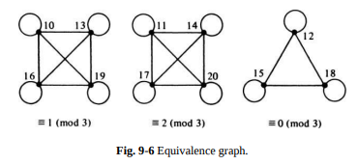
Equivalence Relation
The graph representing an equivalence relation may be called an equivalence graph. What does an equivalence graph look like?
Let us look at an example, consisting of the equivalence relation “is congruent to modulo 3” defined on the set of 11 integers, 10 through 20. The graph is shown in Fig. 9-6. (Recall that each undirected edge in Fig. 9-6 represents two parallel but oppositely directed edges.) In Fig. 9-6 we see that the vertex set of the graph is divided into three disjoint classes, each in a separate component.

Slide 15
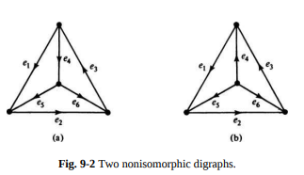
Strong and Weak Connected Diagraph
A digraph G is said to be strongly connected if there is at least one directed path from every vertex to every other vertex.
A digraph G is said to be weakly connected if its corresponding undirected graph is connected but G is not strongly connected.

Slide 16
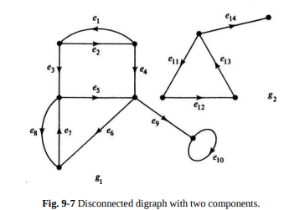
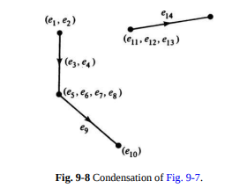
Condensation
The condensation Gc of a digraph G is a digraph in which each strongly connected fragment is replaced by a vertex, and all directed edges from one strongly connected component to another are replaced by a single directed edge.
The condensation of the digraph G in Fig. 9-7 is shown in Fig. 9-8.

Slide 17
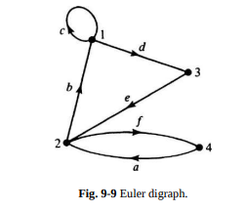
EULER DIGRAPHS
A digraph containing a directed Euler line is called an Euler digraph. The graph in Fig. 9-9 is an Euler digraph, in which the walk a b c d e f is an Euler line.
When is a digraph an Euler digraph? Clearly, the digraph must be connected, with the possible exception of isolated vertices; otherwise, every edge cannot be traversed in one walk. In fact, an Euler digraph must be strongly connected, although every strongly connected digraph need not be an Euler digraph

Slide 18
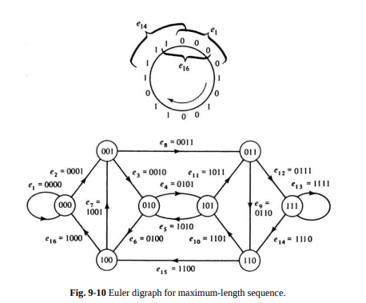
Assignment 8
Teleprinter’s Problem: How long is a longest circular (or cyclic) sequence of l’s and 0’s such that no subsequence of r bits appears more than once in the sequence? Construct one such longest sequence.

Slide 19
THANK YOU

